Slide 1

SIG React 24-07-2018

Slide 2
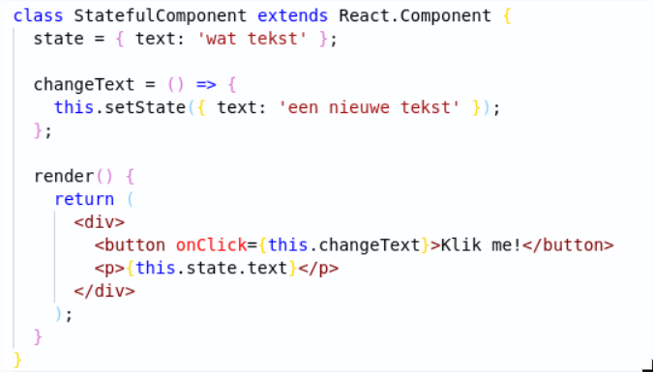


State
React
1

Slide 3

Hands-on Time!
Questions?
React
<number>

Slide 4
Hands-on: Getting started
Git clone https://github.com/AMIS-Services/react-series
Cd into dir sig2/exercise/koa, run `yarn install`, `yarn start-db`, `yarn start`, `yarn seed-db`
Visit localhost:3030/accomodations to verify back-end is working
Cd into dir sig2/exercise/react, run `yarn install` and `yarn start`
Visit localhost:3000 to verify front-end is working
For examples of ES6 syntax, view the file slides/syntax.js
React
<number>

Slide 5
Hands-on: Fetching data
Create a file `src/common/fetch.js`
Create a function which can be called to handle requests to the back-end using `window.fetch()`.
As an option, pass the correct headers (`accept: “application/json”`)
Add error handling for response errors to this function
Add error handling for network errors to this function
Use this function to fetch the accommodations in the lifecyclemethod `componentDidMount()` in `Accommodations.js`. Be aware this is an asynchronous process, so return `null` in the render method until the accommodations have been loaded!
React
<number>

Slide 6
Hands-on: PropTypes
Add PropTypes from the package prop-types
React
<number>

Slide 7
Hands-on: Routing
Create a component which will be shown on 404
Create a component for an accommodations detail page. For now just render ‘hello world’.
Add `<Router>...</Router>` from the package react-router-dom to your App.js
Add a Switch component
Add a `<Route …/>` for path `”/”` to your accommodations component
Add a route for path `”/:id”` to your accommodation detail component
Add a route for path `”*”` to your 404 component
React
<number>

Slide 8
Hands-on: JSS styling
Replace the CSS with react-jss using withStyles from material-ui
React
<number>

Slide 9
Hands-on: Fetching part deux
Edit your accommodation detail component to use `export default withRouter(accommodation)`. WithRouter comes from the package react-router-dom.
Console.log `this.props` to see where your ID is
Use the ID in the lifecyclemethod `componentDidMount` to fetch the detailed information for the accommodation.
Add the information and some styling to the components render function. Don’t forget that fetch is an async action!
React
<number>

